Slide 1
Recommendation System for Videos

Slide 2
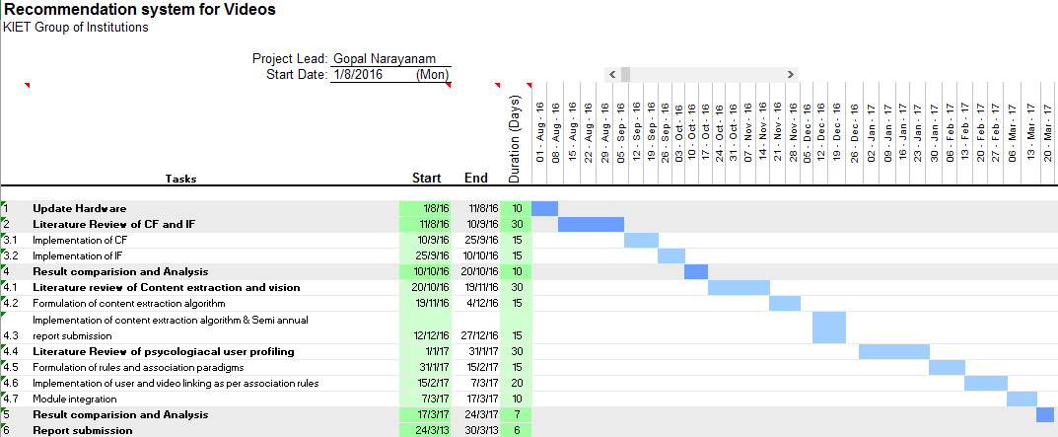
Planning

Slide 3
Contents
Literature Review of CF
Literature Review of IF
Equations and Terminology
Results
References

Slide 4
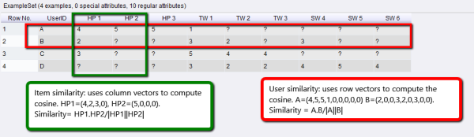
Collaborative filtering (CF)
1. Introduced in 2001 by B Sarwar, G Karypis and J Konstan.
2. Groups user by using a similarity matrix.

Slide 5
Item filtering(IF)
1. Introduced in 2003 by G Linden, B Smith and J York at Amazon.
2. Groups Items by using a similarity coefficient.

Slide 6
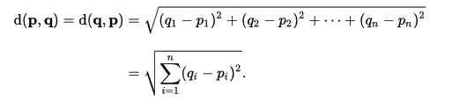
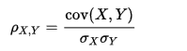
Mathematical formulations
1. Euclidean distance between two samples
2. Pearson Correlation
Where
cov is the covariance
sigma is the standard deviation

Slide 7
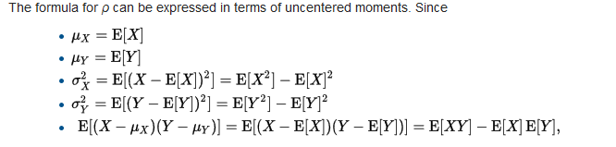

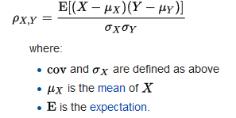

Pearson correlation expansion
The formula for roh an be expressed in terms of uncentered moments as
The formula for roh can be expressed in terms of mean and expectation as
Correlation can be now redefined as :
Where
Ux is the mean of x
E is the expectation
Cov and sigma are as defined earlier
Reduced Pearson correlation

Slide 8
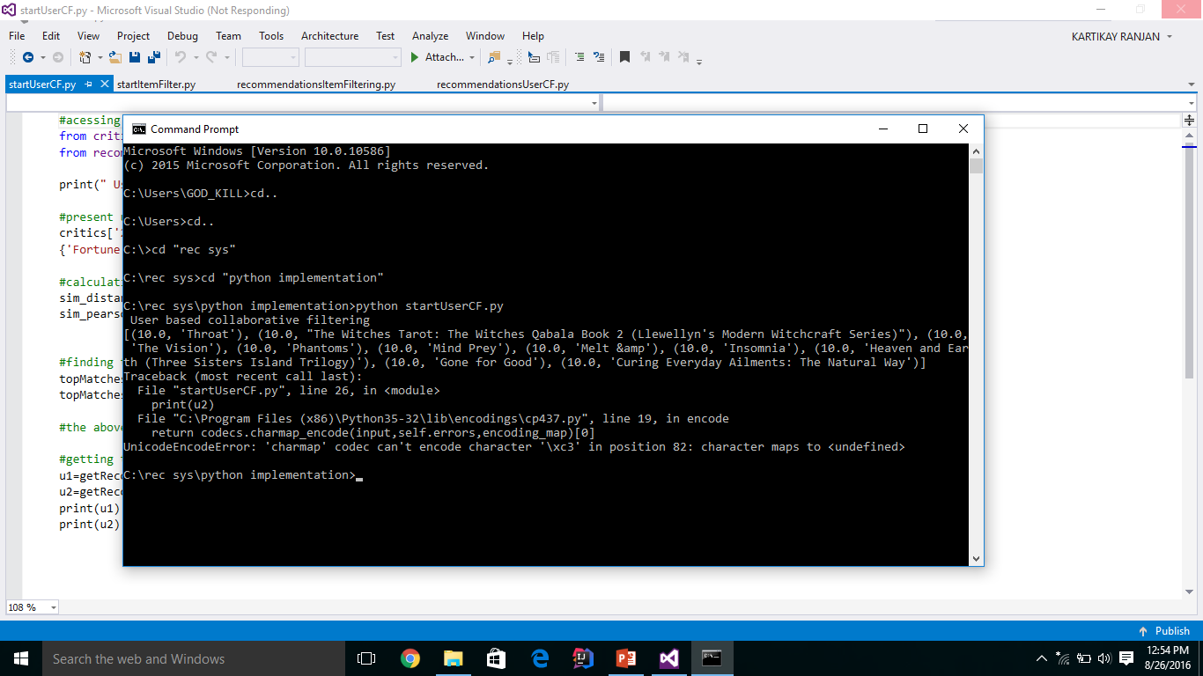
Results

Slide 9
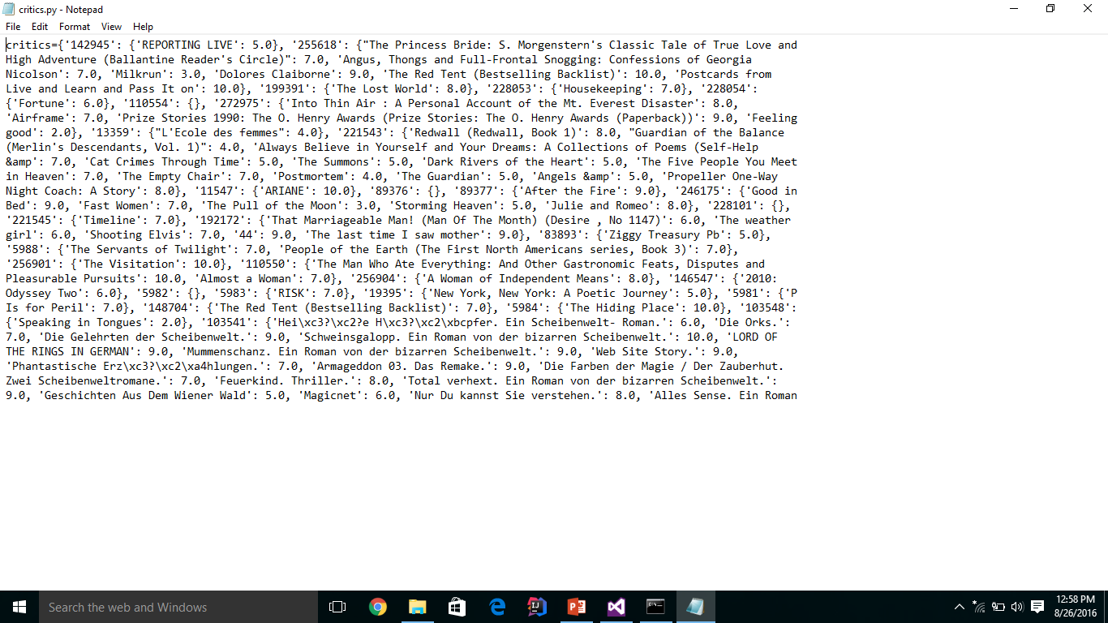
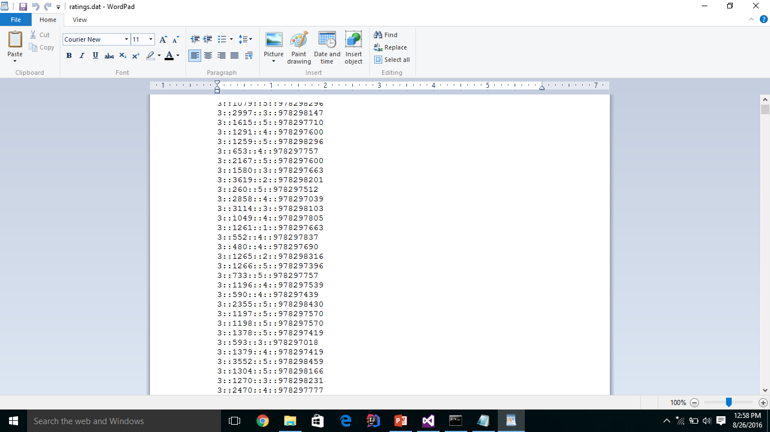

Slide 10
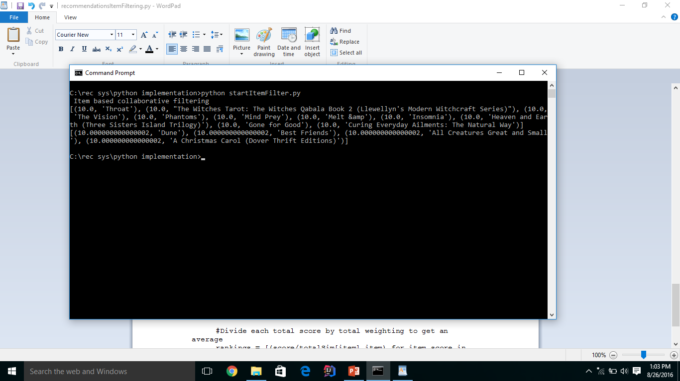

Slide 11
Planning

Slide 12
References
[1] Evan Estola et al. When Recommendation Systems Go Bad, Pages 367-367 . 10th ACM Conference on Recommender Systems 2016
[2] Michael J. Pazzani, Daniel Billsus. The Adaptive Web Volume 4321 of the series Lecture Notes in Computer Science pp 325-341
[3] Xuan Nhat Lam et al. Addressing cold-start problem in recommendation systems. Proceedings of the 11th international conference on Ubiquitous information management and communication 2016
[4] Brian McFee, Luke Barrington, and Gert R. G. Lanckriet. Learning content similarity for music recommendation. IEEE Transactions on Audio, Speech & Language Processing, 20(8), 2012.

Slide 13
[5] Gal Bahar Economic Recommendation Systems: One Page Abstract. Proceedings of the 2016 ACM Conference on Economics and Computation Pages 757-757 ,2016
[6] Jason Weston, Chong Wang, Ron Weiss, and Adam Berenzweig. Latent collaborative retrieval. In Proceedings of the 29th international conference on Machine learning, 2012.
[7] Brian McFee and Gert R. G. Lanckriet. Metric learning to rank. In Proceedings of the 27 th International Conference on Machine Learning, 2010.
[8] Chong Wang and David M. Blei. Collaborative topic modeling for recommending scientific articles. In Proceedings of the 17th ACM SIGKDD international conference on Knowledge discovery and data mining, 2011.
[9] Ruslan Salakhutdinov and Andriy Mnih. Probabilistic matrix factorization. In Advances in Neural Information Processing Systems, volume 20, 2008.

